Slide 1
Coronavirus Tweet
Categorization and Exploration
Group 2:
Gabriel Cruz, Shreeya Kotasthane
Lisa Peterson, Md Main Uddin Rony

Slide 2
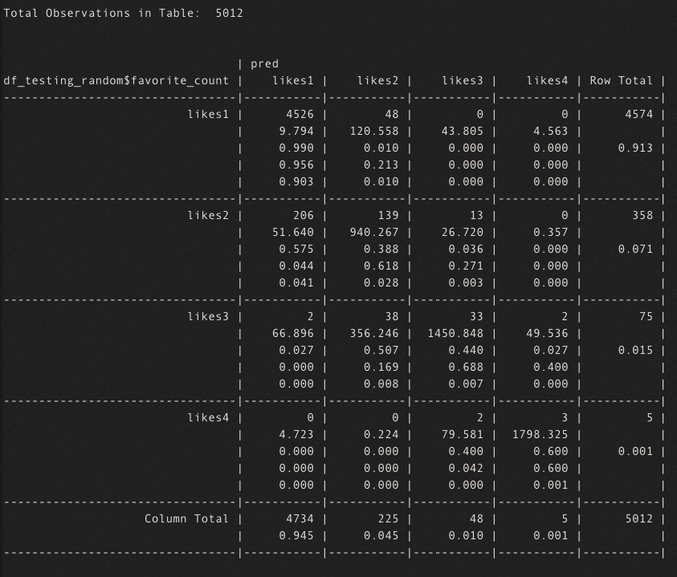
Research Question 1
“Can we predict the number of the retweet or favorite count based on the tweet text and other metadata?”
Part 1 - Likes
Out of all of the models for predicting the likes, the model that performed the best was the random forest with bagging.
Unfortunately, linear regressions demonstrated very poor performance.
While the variables were statistically significant, there really was no clear prediction effect from the variables. Meaning, while they were statistically significant, they really did not do a good job predicting.
Part 2 - Retweets
Much like the tweet likes, out of all of the models for predicting the retweets, the model that performed the best was the random forest with bagging.
Again, linear regressions demonstrated very poor performance.
While most of the relevant variables were statistically significant, there really was no clear prediction effect from the variables.

Slide 3
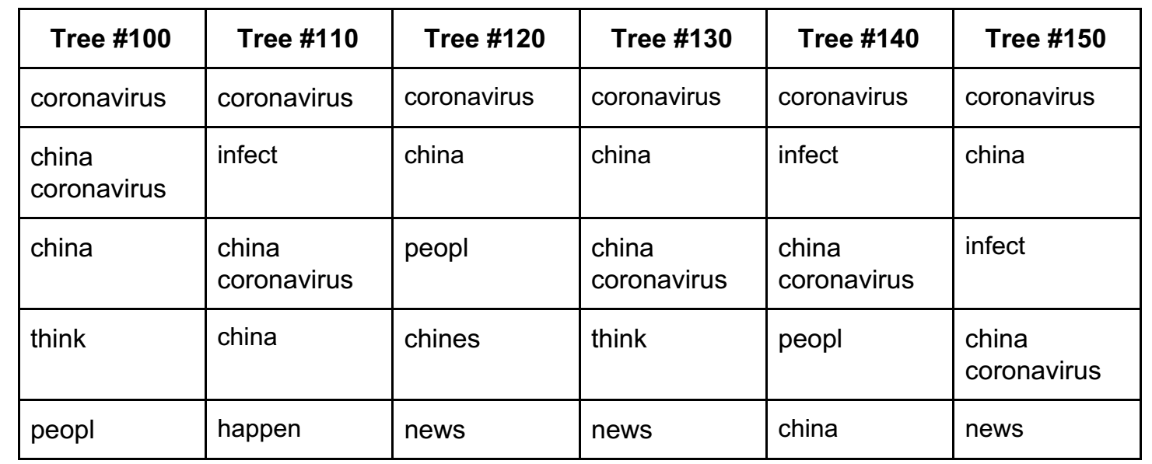
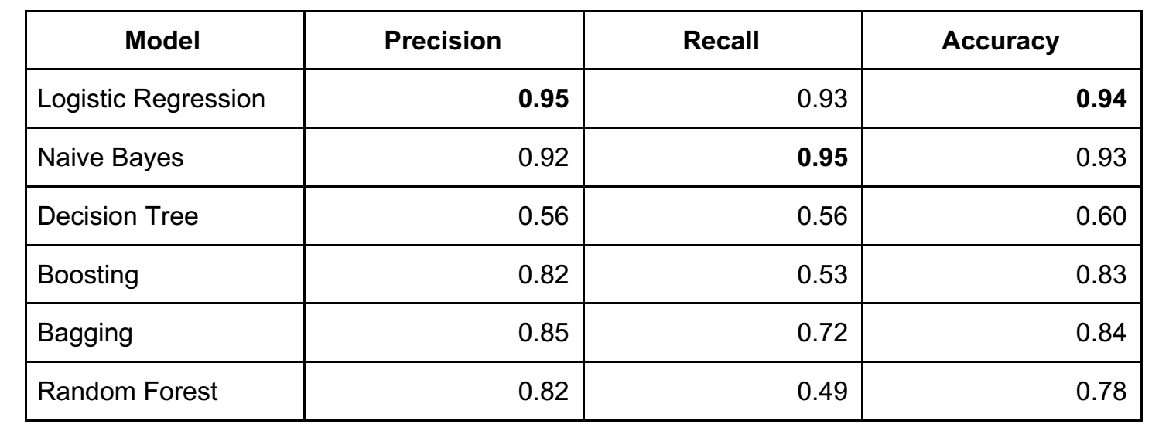
Research Question 2
“Can we predict if the tweet is a conspiracy one using a classification method?”
Annotated 835 tweets (747 Non-conspiracy, 88 Conspiracy)
Over-sampling the conspiracy categories (747 Non-conspiracy, 440 Conspiracy)
Used TF-IDF to vectorize the tweets
2,081 features

Slide 4
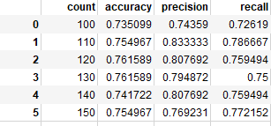
Research Question 3
“Can we predict if a tweet is fear relieving or fear to cause regarding an epidemic from the text and sentiment of the tweet?”
500 Tweets were categorized as Fear Relieving or Fear Causing (250 Causing and 251 Relieving)
Linear Regression was not applicable due to classification of the table.
Bagging did well compared to Decision Tree. Logistical Regression did not perform well.

Slide 5
Research Question 4
“Can we predict if a Twitter user is looking for any
information about the Coronavirus? If so, what type of information are users looking for?”
Annotated 499 tweets as information seeking or not information seeking.
Performed over-sampling the information seeking categories
Used TF-IDF to vectorize the tweets
563 features
Model | Precision | Recall | Accuracy
Logistic Regression | 0.97 | 0.93 | 0.96
Naive Bayes | 0.96 | 0.98 | 0.98
Decision Tree | 0.48 | 0.49 | 0.59
Boosting | 0.87 | 0.54 | 0.84
Bagging | 0.60 | 0.83 | 0.87
Random Forest | 0.60 | 0.81 | 0.85

Slide 6
Conclusion
RQ1 - “Can we predict the number of the retweet or favorite count based on the tweet text and other metadata?”
Bad model performance
Caveat we did not perform vectorization of the text, which could improve model performance.
RQ2 and RQ4 - “Can we predict if the tweet is a conspiracy one using a classification method?” and “Can we predict if a Twitter user is looking for any information about the Coronavirus? If so, what type of information are users looking for?”
Good model performance when using logistical regression and naive bayes.
RQ3 - “Can we predict if a tweet is fear relieving or fear to cause regarding an epidemic from the text and sentiment of the tweet?”
Good performance when using Bagging, compared to Decision Tree.

